Slide 1
Sugon Storage Cloud Storage
Moscow, 12/2015

Slide 2
Data Explosive growth
Large capacity storage system
Data management
Unified management of physical resources
Storage system capacity and performance dynamic extension
Data security
IDC statistics, the world produces 15 PB of data every day, the amount of information data every 18 months to double
IDC statistics, the world's information data to more than 50% annual growth rate of rapid expansion
Notes:
IDC预测，从2009年到2020年，全球数字信息总量将增长44倍，2009～2014年，全球文件数据的年均增长率达将达到60.7%，而块数据的年均增长率只有21.8%。

Slide 3
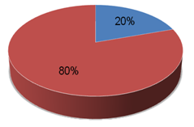
Challenge of unstructured data growth
Most of the way in the file exists
The growth of data is often TB level
File level storage technology
Demand for data sharing
The throughput of the storage system is higher.
手册
支票
图像
Structured Data
即时消息
电子邮件和附件
电子报表
DataBase
Unstructured
PDF
XML
合同
演示稿
Web 页
记录
富媒体
音频和视频
发票
文档

Slide 4
Challenge of increasing the total capacity of storage
The management of storage system is very complex.
Limited capacity of a single storage system
Storage system, the space utilization rate is low
Costs continue to rise, a linear growth trend
IDC predicts that by 2015, the total capacity of the storage device market will reach 2.5EB, the compound annual growth rate of about 24.2%
IDC predicts that by 2015, the total sales of storage equipment will reach 2.2B$, the compound annual growth rate of about 11%

Slide 5
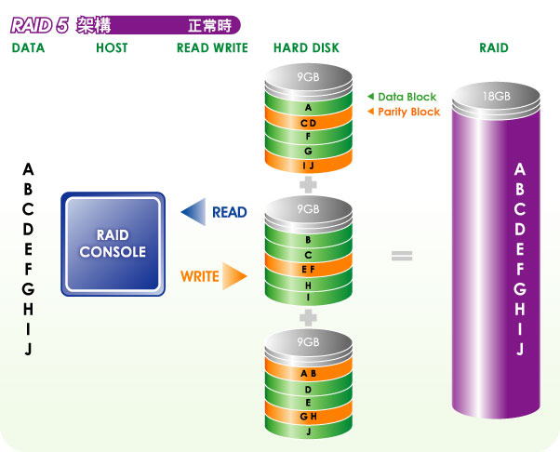
Volume/Performance increase rapidly
2003 | 160GB
2007 | 1TB
2011 | 3TB
Single disc capacity rapid increase
Disk performance is quite limited
Disk capacity of small, fast data recovery, using Raid5/6 data security is good
Disk capacity becomes large, Raid reconstruction time is long
Second disk failure probability increase
challenged by performance and reliability.

Slide 6
Primary Design Principle
A large-scale storage system, which is constructed with high performance, high availability and low TCO, is constructed with relatively inexpensive industrial standard units.
Failure as the main component of the normal consideration
Network
Connection
Servers
Using clustering architecture, modular design principles, and building a global unified large-scale file sharing system
Hard Disks
Notes:
云存储 存储的数据量往往比较大，可靠性

Slide 7
Storage Requirement
storage capacity
15TB per 7 days for 5K Camera.
Storage throughput
Each camera is 300Kbps, 10K road data transmission bandwidth=300Kbps*10K= 367MB/s.
Storage Networking
10Gb/1Gb Ethernet.
30TB per 7 days for 10K Camera.
Assume that the data storage for a month
10K Camera, A total capacity demand = 30TB*4*1.5=180TB , data redundancy is 4+2:1.
Support load balancing and redundancy.

Slide 8
Solution Configuration(5K Cams)
No. | Name | description | Qty
1 | Server | CPU: E5-2640v3 2.6G 20M 8C*2 MEM:32GB Cache network interface:1GbE/10GbE Power Supply: 1+1 redundant power DISK: 2T SAS*2 | 10
2 | oPara(Metadata Node) | CPU: 2*Intel Xeon E5-2600 v3 series processor MEM:64GB Cache network interface:1GbE/10GbE Power Supply: 1+1 redundant power DISK:240GB SSD *4+300GB SAS*4 RAID Controller: raid 0/1/5/6 | 2
3 | oStor(Data Node) | CPU: 2*Intel Xeon E5-2600 v3 series processor MEM:32GB Cache network interface:1GbE/10GbE Power Supply: 1+1 redundant power DISK:300GB SAS *2+4TB SATA *22(provide 88 TB capacity) SAS Controller: 12.0Gb/s SAS , RAID 0/1/10 | 4
Description:
1. Storage naked capacity = 88TB * 4 = 352 TB, effective capacity = 352TB * 0.8 = 235 TB
2. allow any one disk/one data node failure

Slide 9
Solution Configuration(10K Cams)
No. | Name | description | Qty
1 | Server | CPU: E5-2640v3 2.6G 20M 8C*2 MEM:32GB Cache network interface:1GbE/10GbE Power Supply: 1+1 redundant power DISK: 2T SAS*2 | 20
2 | oPara(Metadata Node) | CPU: 2*Intel Xeon E5-2600 v3 series processor MEM:64GB Cache network interface:1GbE/10GbE Power Supply: 1+1 redundant power DISK:240GB SSD *4+300GB SAS*4 RAID Controller: raid 0/1/5/6 | 4
3 | oStor(Data Node) | CPU: 2*Intel Xeon E5-2600 v3 series processor MEM:32GB Cache network interface:1GbE/10GbE Power Supply: 1+1 redundant power DISK:300GB SAS *2+4TB SATA *22(provide 88 TB capacity) SAS Controller: 12.0Gb/s SAS , RAID 0/1/10 | 8
Description:
1. Storage naked capacity = 88TB * 8 = 704 TB, effective capacity = 704TB * 0.8 = 563 TB
2. allow any one disk/one data node failure

Slide 10
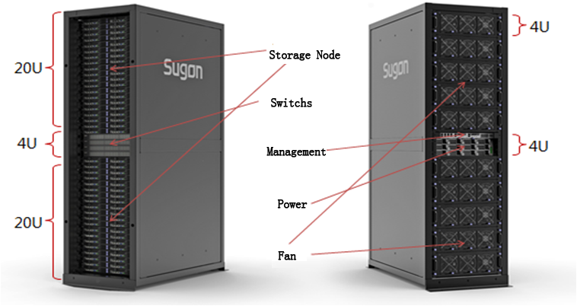
Product form
Whole cabinet Storage System modules
Adopted the modular design, by the cabinet frame, warehouse, computing nodes, power supply, heat dissipation and management module.
Support 40U storage node space and 4U exchange equipment space, the largest 20 storage node can be configured(1.5PB).

Slide 11
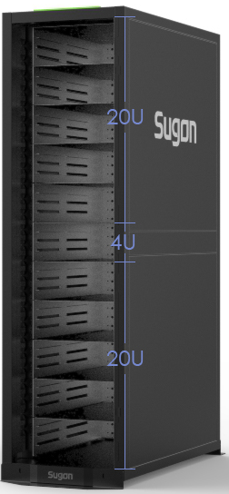
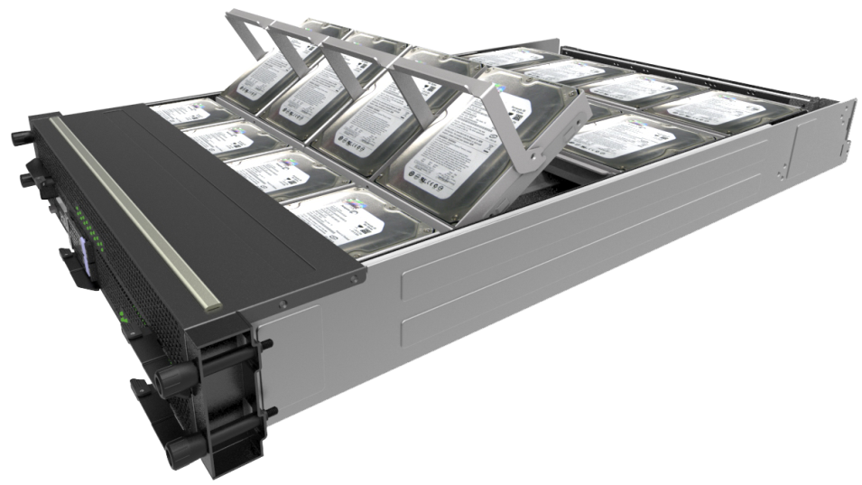
Storage Node
Storage Node: 2U Storage Node No power/fan design reduce the point of failure
Processor | 2*Intel Xeon E5-2600 v3 series processor
Memory | 8 memory slot, DDR3 1866/1600/1333MHz
SAS control | 6.0Gb/s SAS, RAID 0/1/10
Disk | 2 *2.5” SAS/SATA/SSD +22* 3.5” SAS/SATA
VGA | Integrated graphics controller
High speed network | PCI-E 3.0 x16 slot，Support 1*56Gbps FDR or 2*10GE
Gigabit networks | 2*1GBE
System Management | Onboard BMC management chip, IPMI2.0 standard management functions

Slide 12
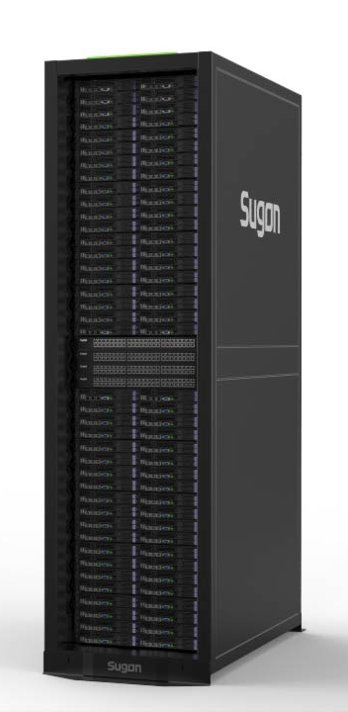
Solution Strengths
expansibility
Higher density
Easy
maintainable
Energy
conservation
Lower Costs
Higher
performance
low noise
ParaStor help user to build EB level data sharing platform！

Slide 13

System Framework
1. Management Controller
- Provide two interfaces ( Command line and GUI);
- Embedded management system to monitor the whole system.
1
2. Index Controller
- Manage all metadata and namespace
- Cluster architecture, Active-Active method
2
ParaStor200
3
3. Data Controller
- Provide data storage space
- Support automatic data recovery
4
4. Client Drive
- Provide POSIX file access interface
- Support Linux/Windows clients

Slide 14
System Architecture
client
metadata read-write
concurrent read-write
concurrent read-write
concurrent read-write
Index controller
Index controller
……
Index controller
data controller
data controller
data controller
Index controller
MGR
MGR
data migration
data migration
management network
data controller
data controller
……
data controller
archive

Slide 15

Client Product Form
Clients (Linux/Windows)
Data read-write
Request data Get metadata information
Data controller
Data controller
Index controller
Data controller
Data controller
Index controller

Slide 16
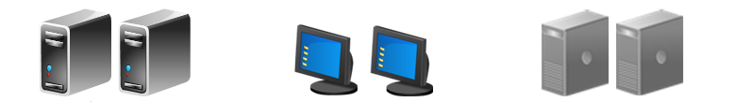
NAS Cluster Product Form
Linux
Desktop
Virtualization
NFS
CIFS
HTTPS
FTP
NAS Cluster Manage System
Global Shared Cache
Data Controller
Data Controller
Data Controller
Data Controller
Data Controller
Data Controller
  Global Shared Cache: Single NAS node failure cannot lose the cached data.
  Apply to virtualization application, such as VMWare, Citrix.

Slide 17
Product Features
ParaStor200
High performance
High reliability
High usability
Low TCO
High scalability
Large capacity

Slide 18
Large Capacity
ParaStor200
Index controller cluster
Files at a 10 billion level
Data controller cluster
EB level storage capacity

Slide 19
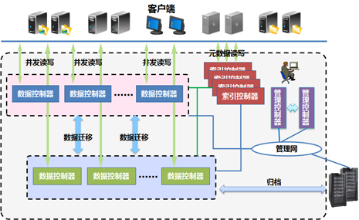
Ultra-high IO Performance
Parallel cluster architecture design to satisfy high concurrent IO requirement
2.5GBps
2.5GBps
2.5GBps
Full active index cluster improves the processing ability of massive small files
2.5GBps
2.5GBps
2.5GBps
Aggregated bandwidth, which is the sum of data controller bandwidth, increases linearly with capacity
Strip optimization provides high single stream IO bandwidth

Slide 20





High reliability——Node fault tolerance
/home
/home/appl/data/web/important_big_spreadsheet.xls
/home/appl/data/web/important_big_spreadsheet.xls
/appl
/home/appl/data/web/big_architecture_drawing.ppt
/home/appl/data/web/big_architecture_drawing.ppt
/data
/home/appl/data/web/unstructured_big_video.mpg
/web
/home/appl/data/web/unstructured_big_video.mpg
Logical layer
Index controller
Index controller
Switch2
Switch1
6
7
8
9
10
11
0
1
2
3
4
5
6
7
8
9
10
11
0
1
2
3
4
5
a
b
c
d
e
f
g
g
h
h
i
i
j
j
k
k
l
A
B
a
b
c
d
e
f
l
B
C
D
E
F
G
H
I
J
K
L
A
C
D
E
F
G
H
I
J
K
L
Physical layer
0
1
2
A
B
C

Slide 21
High utilization data protection solution ：N+M
D0
Node1
Node2
Node3
Node4
Node5
D1
D0
D1
P0
D2
D3
D2
D3
D4
D5
D6
P1
D7
D4
N+M:B,
N represents the number of data blocks,
M represents the number of fault-tolerance disks ,
B represents the number of fault-tolerance nodes.
D5
D6
D7
N+M is a higher utilization solution on the premise of data reliability!

Slide 22

High scalability
LAN
Parallel data I/O
Parallel data I/O
Data controller
Data controller
Data controller
Data controller
Data controller
Data controller
1
2
1
2
1
2
After expansion
3
4
3
4
3
4
Data controller
Data controller
Data controller
1
2
1
2
1
2
Add Data Controller
Data migration automatically
Initial state
3
4
3
4
3
4

Slide 23
Type of Interface
Access interfaces
Private Linux, Windows kernel access interfaces
Standard NFS, CIFS interfaces
POSIX API
MapReduce programming interface
REST programming interface
SOAP programming interface
SNMP interface
Network interface
20Gb/40Gb/56Gb IB
10Gb/1Gb Ethernet
Support load balancing and redundancy

Slide 24
Rich Access Interface
Internet
application
server
FTP storage
servers
Management
and
monitoring
● ● ●
NFS,CIFS,REST ……
SNMP
I/O node
应用节点
I/O node
应用节点
I/O node
应用节点
VFS
VFS
● ● ●
VFS
oApp
oApp
oApp
ParaStor

Slide 25
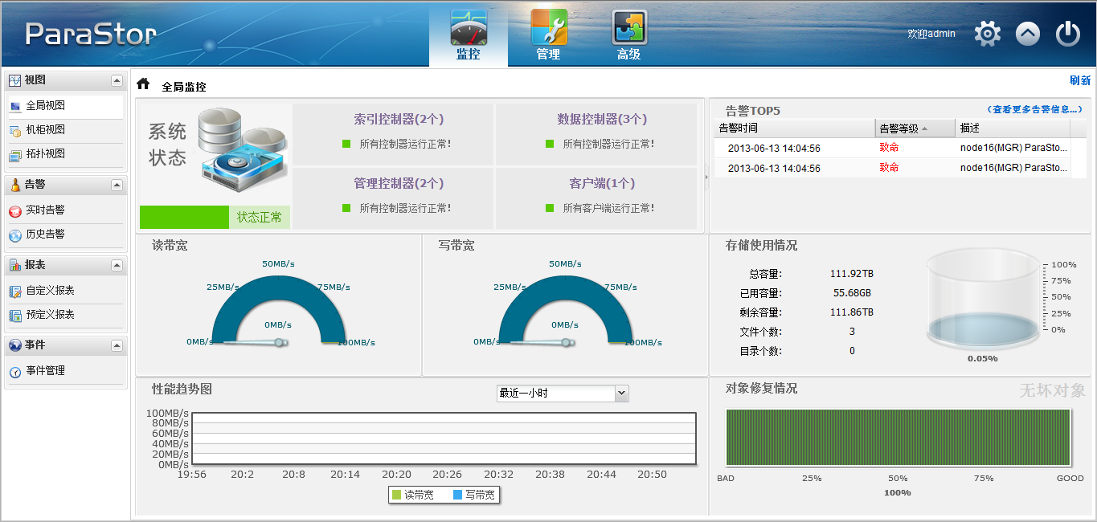
Usability
ParaStor web management interface
Include Monitoring systems 、 System management 、 Advanced management Easy to management and monitoring storage system software and hardware resources.

Slide 26
Low TCO
Low purchase costs
Adopt X86 architecture hardware
Low management costs
Automated troubleshooting
Administrators rarely involved
Buy on demand
Capacity and performance can be dynamically expanded
No need to spend much one-time fund
Software and hardware integration storage system
5 years after-sale services for both hardware and software

Slide 27

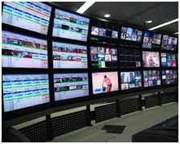


Typical Application Field
HPC
Climate
Oil Field
Gene Research
Material
Radio/TV
IPTV
Video Editing
Render Farm
Consumer Behaviors
Internet
Online Video
Online Music
Social Network
Online Store
Cloud Storage
Online Storage Space
Online Storage Rent
Cloud Backup & DR
Huge files Sharing

Slide 28
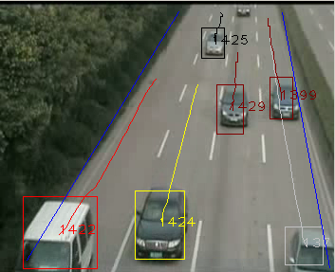
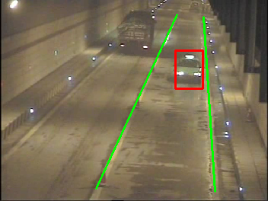
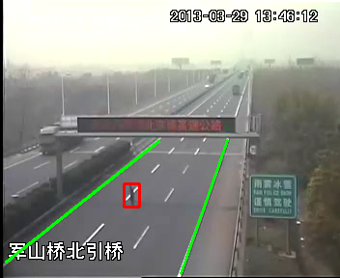
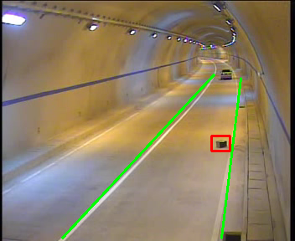
Changchun Traffic Police
➲ 流量统计
➲ 逆行
Scale：6*oStor
Applicants：
Traffic video data storage
Law enforcement recorder data
Virtualization storage platform
➲ 高速行人
➲ 抛撒物检测
ParaStor

